Slide 1

LockBox
Course Code: CSE 3200
Course Title: Software Development Project ||
Project Mentor: Mst. Sahela Rahman
Team Members:
Md Samiul Islam -> ID: 0322320105101001
Simanto Sarkar -> ID: 0322320105101003
Chanchal Kumar -> ID: 0322320105101055
Batch: 23rd
Semester: 6th
Dept: Computer Science & Engineering
Date: 28 February, 2026

Slide 2
Topic to be discussed
Introduction
Objective
Existing Work
Proposed Methodology & Tools
Architecture Diagram, Logic Flowchart & ER Diagram
Project's Expected Result
Project Tentative timeline
Conclusion and Future work
References
1

Slide 3
Introduction
As digital footprints expand, the average user manages dozens of unique credentials. This has led to two dangerous behaviors: "password recycling" or reliance on centralized cloud-based managers. While convenient, cloud managers represent a single point of failure and an attractive target for sophisticated state-level and independent hackers. LockBox is a desktop-based "Zero-Knowledge" utility designed to eliminate these risks by ensuring that sensitive data never leaves the user's local hardware.
2

Slide 4
Objective
Hardened Encryption: To implement a "double-wall" security layer using PBKDF2 for key derivation and AES-256-GCM for data encryption.
Data Sovereignty: To utilize SQLite as a localized, serverless database engine, ensuring the user has total physical control over their vault file.
Zero-Knowledge Architecture: To ensure that the application itself never knows the Master Password; it only facilitates the math required to unlock the data.
Modern UI/UX: To provide a streamlined, "Flat Design" interface that makes security accessible rather than cumbersome.
3

Slide 5
Existing Work
Before designing LockBox, we analyzed industry leaders to identify security gaps and best practices:
KeePass (Local-Only): The gold standard for local password management. It uses the .kdbx file format. While highly secure, its UI is often cited as dated and complex for average users.
Bitwarden (Open Source): Known for its transparent security audits. It uses PBKDF2 with 600,000+ iterations for key derivation. LockBox adopts this standard for local deployment.
LastPass (Cloud-Based): Suffered major breaches in 2022/2023. This reinforces the need for local-only managers where the user—not the provider—holds the encrypted vault.
Key Findings: The "Master Password" must never be stored. Instead, a derived key must be used for encryption, and a high-iteration hash should be used for authentication to prevent brute-force attacks on modern GPUs.
4

Slide 6
Proposed Methodology
1. Key Derivation: PBKDF2 with HMAC-SHA256
The Master Password is not used directly. Instead, we use PBKDF2 (Password-Based Key Derivation Function 2):
Salt: A unique 16-byte random salt stored in the DB.
Iterations: 600,000 (minimum).
Derived Key: 256 bits.
Purpose: This makes "offline" brute-force attacks extremely slow and expensive for hackers.
5

Slide 7
Proposed Methodology
2. Encryption: AES-256-GCM
While many apps use AES-CBC, LockBox uses AES-GCM (Galois/Counter Mode).
Why GCM? Unlike CBC, GCM provides Authenticated Encryption. It ensures that the data has not been tampered with by adding an Authentication Tag to the encrypted block.
IV (Initialization Vector): A unique 12-byte IV is generated for every single password entry to prevent pattern recognition.
6

Slide 8
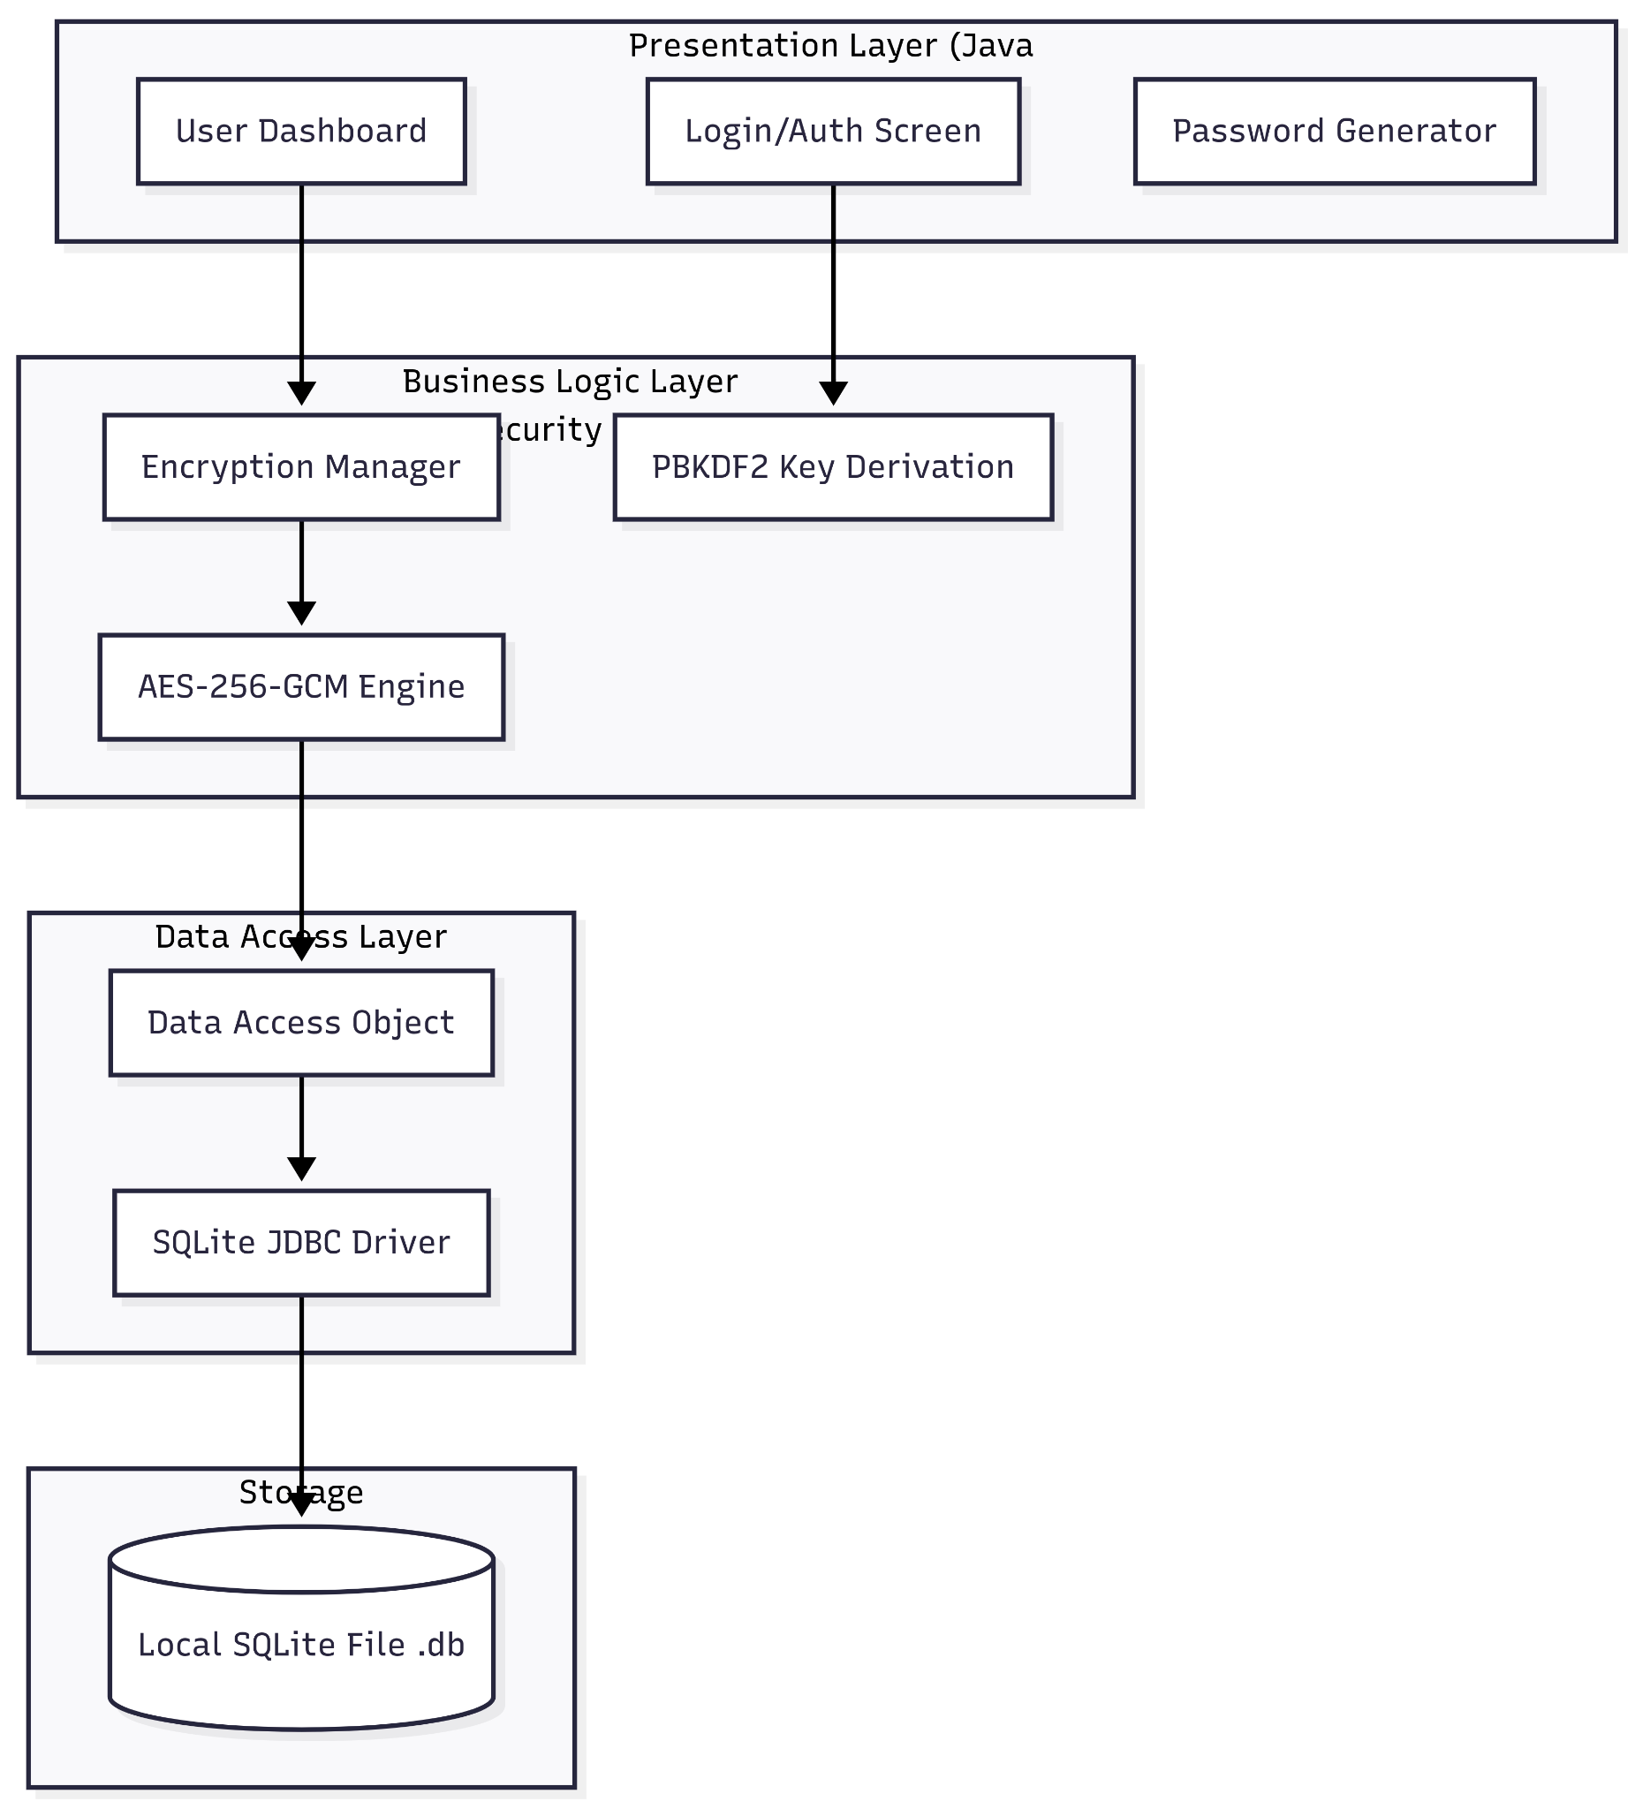
Proposed: Architecture Diagram
7

Slide 9
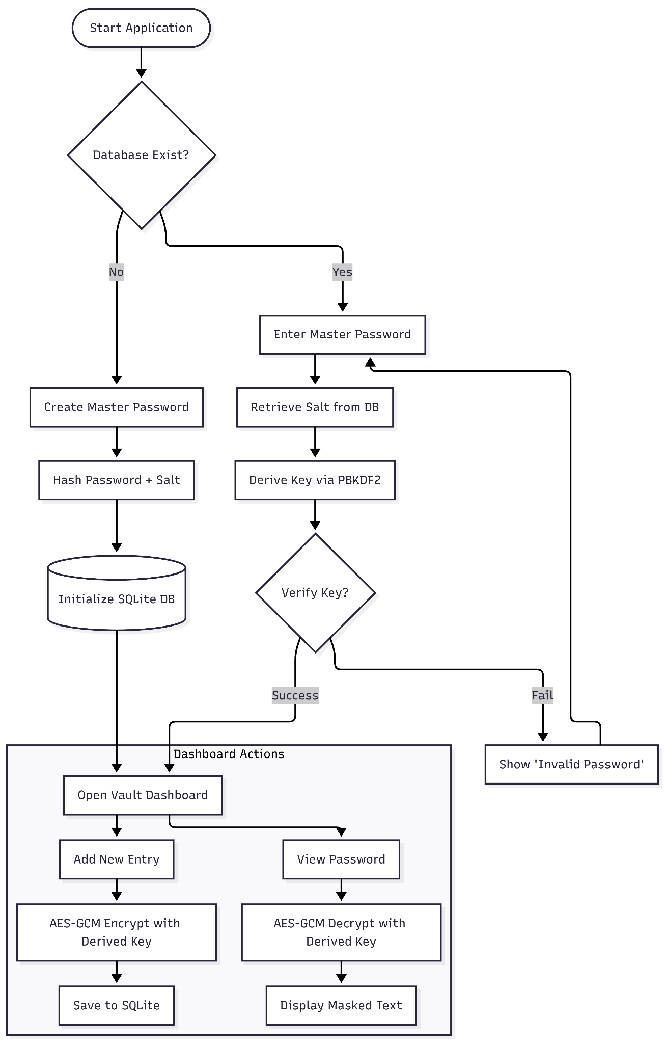
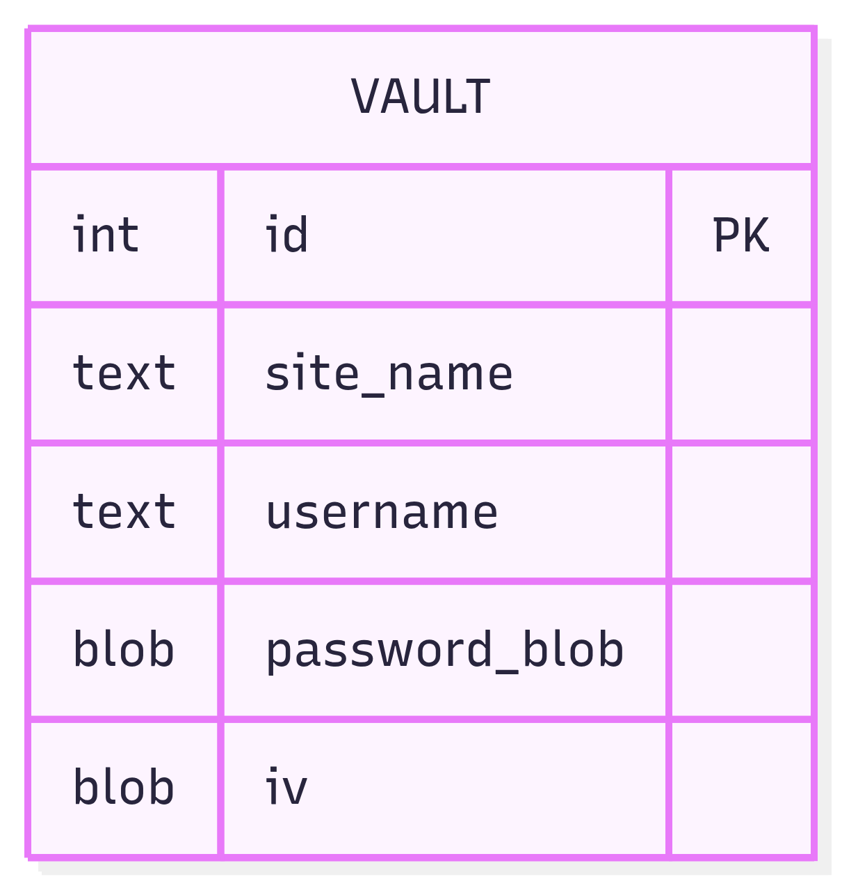
Proposed: Logic Flowchart and ER Diagram
8

Slide 10
Project's Expected Result
A Standalone Executable: A JAR or native installer for the LockBox application.
Encrypted Local Vault: A .db file that is cryptographically secure even if stolen.
Security Documentation: A guide explaining the implementation of the AES-GCM and PBKDF2 parameters.
Feature-Complete UI: A functional dashboard allowing for full CRUD (Create, Read, Update, Delete) operations on user credentials with automated "Clip-and-Clear" clipboard safety.
9

Slide 11
Conclusion and Future Work
Conclusion (The Now) | Future Work (The Next)
✓ Local-First Security Architecture | → Browser Extension for Auto-fill
✓ Military-Grade AES-256-GCM Encryption | → Biometric (Fingerprint) Unlocking
✓ 100% User Data Sovereignty | → Mobile View-Only Companion App
✓ Zero-Knowledge Logic Flow | → Encrypted Cloud Backup Support
9

Slide 12
References
NIST Special Publication 800-63B: Digital Identity Guidelines regarding password complexity and storage. [Original Source: nist.gov]
OWASP Password Storage Cheat Sheet: Recommendations for PBKDF2 iterations and salt lengths. [Original Source: owasp.org]
SQLite Documentation: For local storage implementation. [Original Source: sqlite.org]
Java Cryptography Architecture (JCA) Reference Guide: Implementation of Cipher and SecretKeyFactory. [Original Source: oracle.com]
10

